Slide 1
Forecasting Particulate matter in Delhi
Author by: Priyanka Biswas

Slide 2
Business Problem:
Forecast in Delhi to understand the air quality on an hourly basis for 4 months.
Objective:
Particulate matter (PM ) has been recorded in Delhi to understand the air quality on an hourly basis for 4 months. Our objective is to forecast the data available.

Slide 3
Project Architecture / Project Flow
Understand the domain and identify the business problem
Data Understanding
Data Cleaning and Preparation
(EDA)
Deployment
Validate Model
Develop Model

Slide 4
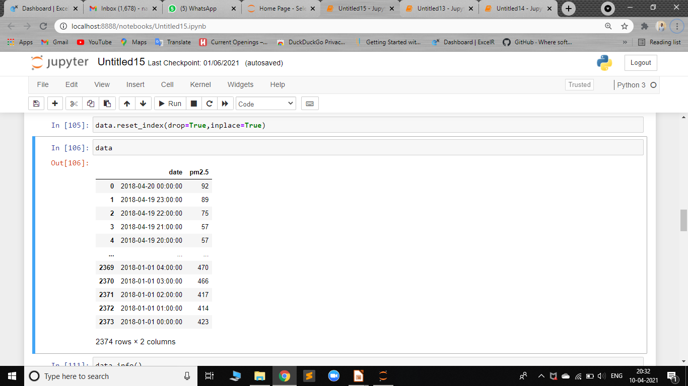
Data set details
The dataset contains total 2374 records of Date and pm2.5. Date column contains date with hourly records of pm2.5
In pm2.5 column there are, total 80 null values.
In date column there are, 243 missing timestamps.
The record is from 01/01/2018 to 20/042018.
Maximum particle present was on 2nd Jan 2018 = 492.
Minimum particle present was on 12th April 2018 =1’
Count-2374,mean-191.87,std-125.529,25%-76.61
50%-163,75%-316

Slide 5
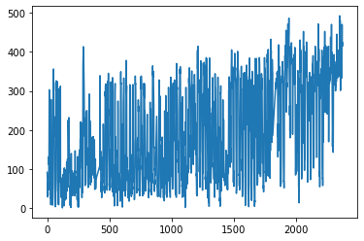
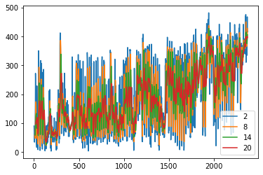
Exploratory Data Analysis (EDA)
Treating null values: As there were 80null values(‘-’ missing values) we have performed linear Interpolation imputation on all these null values. And the mean of this dataset is 191.87. we see a decreasing trend and Additive seasonality.

Slide 6
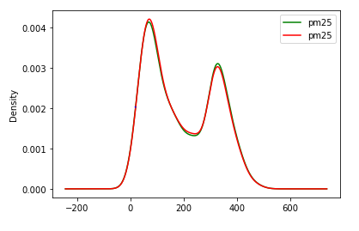
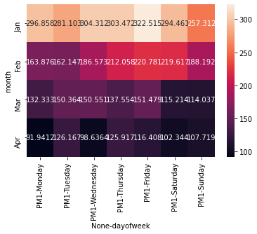
Interpolation of missing values:
Method =Interpolation(linear) The following graph shows the distribution of the values before and after the interpolation of the missing values. Trying the different method of the treating the missing values the linear interpolation method gives the best result.

Slide 7
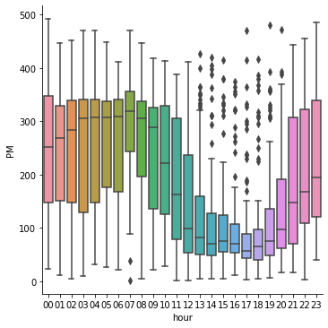
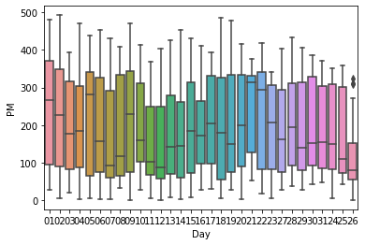
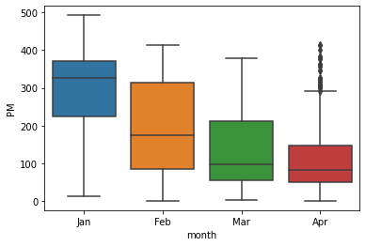
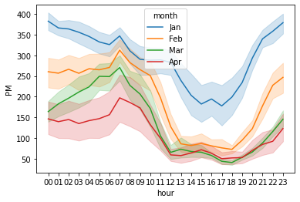
Box plot & line Plot:

Slide 8
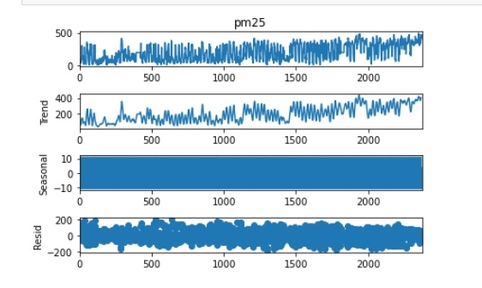
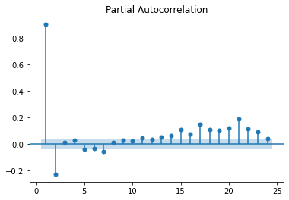
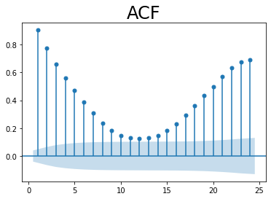
Decomposition Plot
ACF & PACF

Slide 9
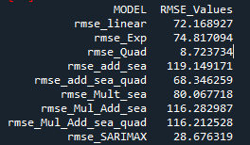
Model Building
Seasonal Autoregressive Integrated Moving Average, SARIMA or Seasonal ARIMA, is an extension of ARIMA that explicitly supports univariate time series data with a seasonal component.
It adds three parameters to specify the autoregression (AR), differencing (I) and moving average (MA)
for the seasonal component of the series, as well as an additional parameter for the period of the seasonality(m).Here, we have taken p=2, d=1,q=1 & m=4

Slide 10
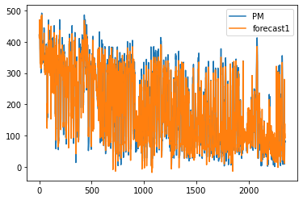
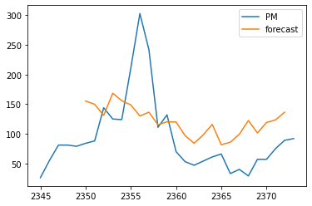
Model Building: A seasonal autoregressive integrated moving average (SARIMA) model is one step different from an ARIMA model based on the concept of seasonal trends. In many time series data, frequent seasonal effects come into play. There will be a seasonal effect on a yearly basis or monthly basis , and the data in this particular season will definitely have a strong correlation with the data measured last year in the same season.

Slide 11
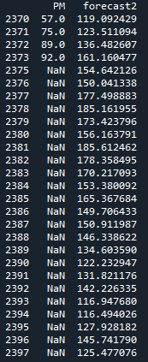
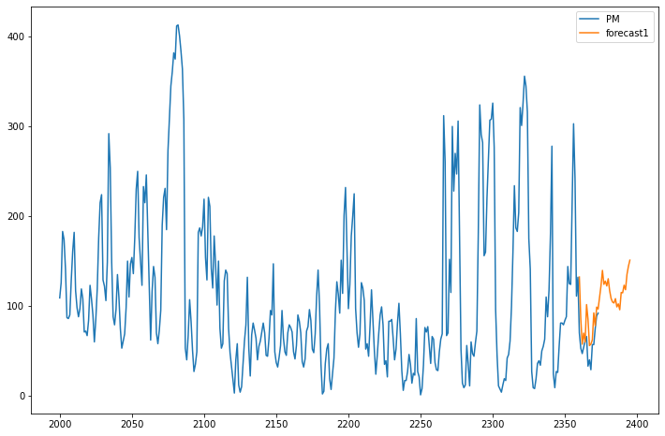
Model Predictions: These are the predicted results for the next 24 hours

Slide 12
Challenges faced?
Data conversion.
Interpolate missing value.
Predicting the time series on hourly basis.
Plotting graphs in deployment.
How did you overcome?
Data conversion by analyzing the data types of data (PM) values are numbers stored as string.
Missing values were filled using nearest interpolation method.
Performing different models and comparing RMSE values.
Used different logics to plot graph in deployment in streamlet.

Slide 13
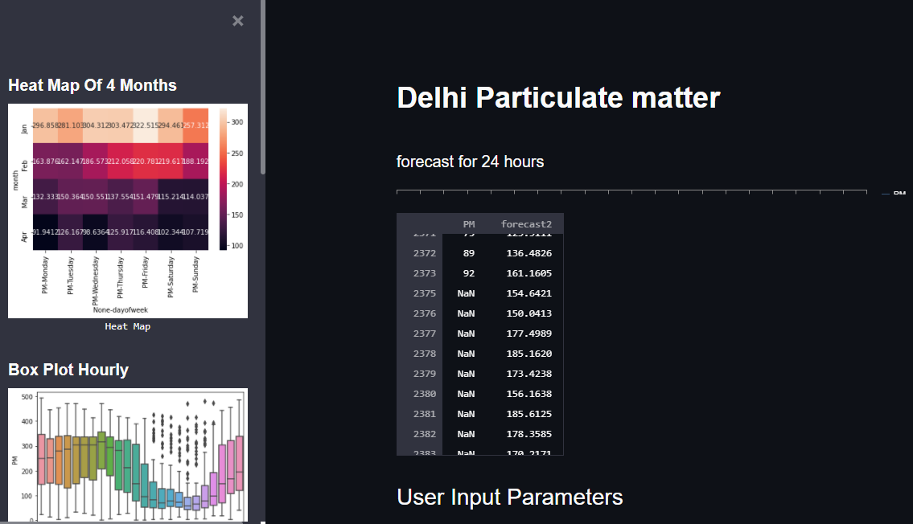
Web page deployment

Slide 14
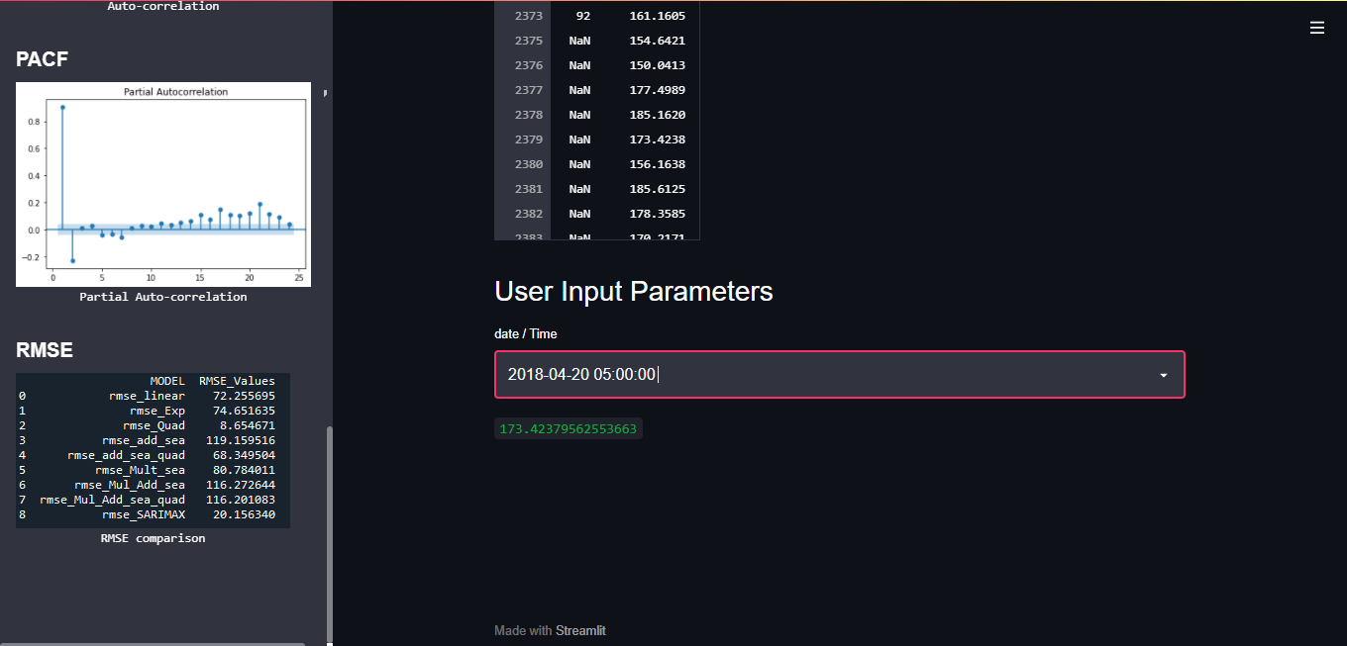

Slide 15
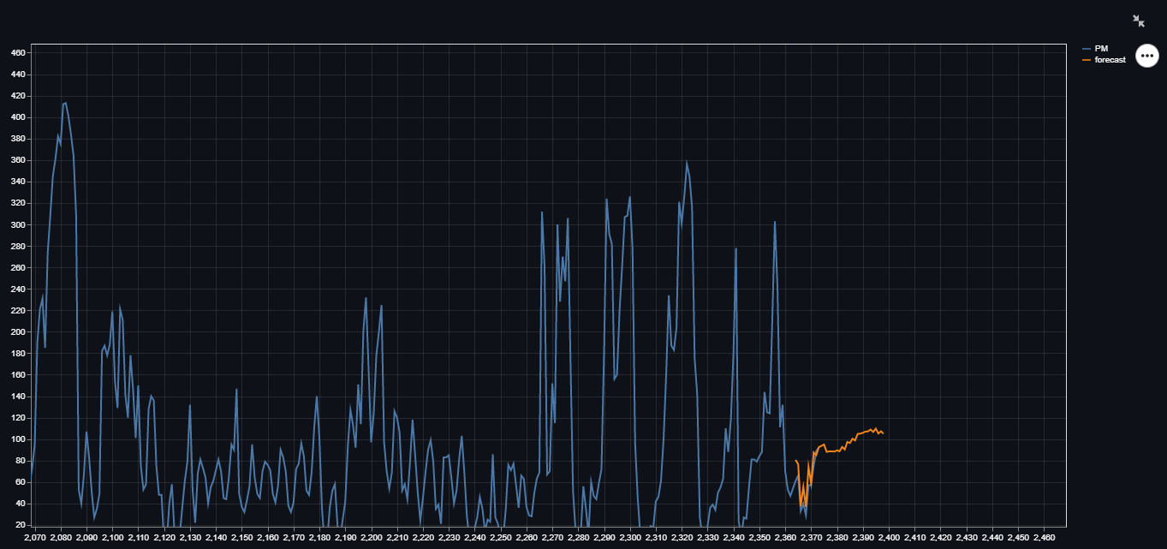

Slide 16
Thank you

